Slide 1
Welcome
Big Data Programming: Python Project On
ResuMatch: Resume Processing Web App
By,
Samiksha & Aswin

Slide 2
Introduction
Purpose of the Project:
Develop a web-based system to automate resume screening and job category prediction.
Allow users to upload resumes (PDF/DOCX), analyze them, and match them to job descriptions.
Purpose:
Enhance Recruitment Efficiency by automating the initial screening process.
Improve Job-Resume Matching to recommend more suitable candidates for job roles.

Slide 3
Key Features
Resume uploading and Parsing:
Users can upload resumes in PDF or DOCX format.
Extract text from resumes using PyPDF2 and python-docx.
Text Processing:
Clean and process text (lowercasing, stopword removal, stemming).
Skill Extraction:
Extract skills from resumes using both fuzzy matching and spaCy-based Named Entity Recognition (NER).
Job Matching Score:
Calculate job description match score based on shared words between resume and job description.

Slide 4
Tools and Technologies used
Sr no. | Tool | Use case
1. | Flask | Web Framework to build the web app
2. | PyPDF2 & python-docs | For reading and extracting text from resumes
3. | NLTK | Used for Text processing (like stemming, tokenization, etc)
4. | spaCy | Used for advanced NLP tasks like Name Entity Relationship (NER)
5. | FuzzyWuzzy | For Fuzzy matching of skills
6. | Scikit-learn | For building a resume classification ML model
7. | TfidfVectorizer | Text vectorization for model training
8. | Naïve Bayes | Classifier for job category prediction
9. | HTML, CSS, JavaScript, Bootstrap | Frontend technologies for building the UI
10. | Render | Cloud platform for deploying the web app

Slide 5
Detailed Workflow
User uploads the resume and job description via a form on the website
The text is extracted from uploaded PDFs or DOCX files.
The extracted text is cleaned (stopword removal, stemming).
Skills are extracted using fuzzy matching or spaCy NER.
The resume’s relevance to the job description is calculated based on keyword matching.
A trained machine learning model predicts the appropriate job category.
The system displays the match percentage, predicted job category, and a list of extracted skills.

Slide 6
Frontend
Building the Web Interface
Decided on HTML, CSS, JavaScript, and Bootstrap for styling and responsiveness and created a clean and intuitive homepage with a file upload section.
Designed a drag-and-drop or browse upload option for resumes and forms for inputting Job Title and Job Description.
Form Handling & File Upload
Implemented an HTML form with an input field to accept PDF and DOCX files.
Integrated Flask routes to handle file submission and process resumes.
Used JavaScript for basic client-side validation (e.g., checking file type & size).

Slide 7
Frontend
Displaying Results
Created a results page to display extracted resume information.
Enhancing User Experience
Used Bootstrap & CSS for a professional and mobile-friendly layout.
Here it matching percentage with job description using Cosine Similarity and added category-wise scoring
Added loading indicators while processing resumes.
Included error messages & success notifications for better feedback.
Tested the interface on different browsers & devices for compatibility.

Slide 8
Model Training
ML Pipeline
TfidfVectorizer: Converts resume text into numerical vectors (using bigrams and min_df/max_df filtering).
Naive Bayes Classifier: Classifies resumes into predefined categories (e.g., Data Science, Software Engineering).
Training
Dataset is pre-processed (cleaning, tokenizing).
Model is trained on labelled resume data, validated using a test set.
Model Evaluation
Evaluated using precision, recall, and F1-score.
Save the trained model for prediction during real-time use.

Slide 9
Implementation Details
Backend
Flask handles HTTP requests, serves templates, and processes files.
The train_model.py handles model training and prediction.
Frontend
HTML templates (Bootstrap) are used for designing forms, results, and file upload interfaces.
JavaScript is used for interactivity (e.g., showing results without refreshing the page).
Error Handling
Graceful error messages for invalid file uploads, missing fields, etc.

Slide 10
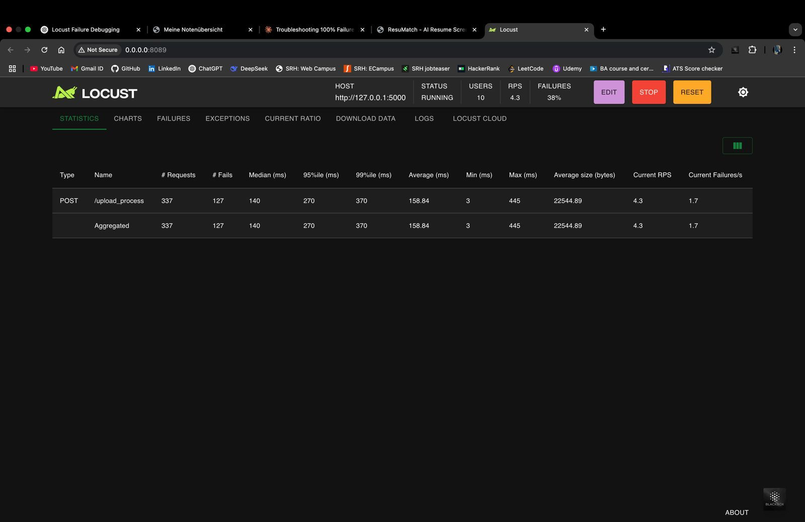
Testing and Quality Assurance
Unit Testing
Individual components like text preprocessing, skill extraction, and model prediction are tested.
Integration Testing
The integration of components (e.g., text extraction, ML model prediction) is verified to work end-to-end.
Performance Testing
Load testing to ensure the application can handle a reasonable number of users.
Optimizations for file size limits and processing time.
Tools for Testing
Used pytest for unit testing and integration testing and locust for performance testing

Slide 11
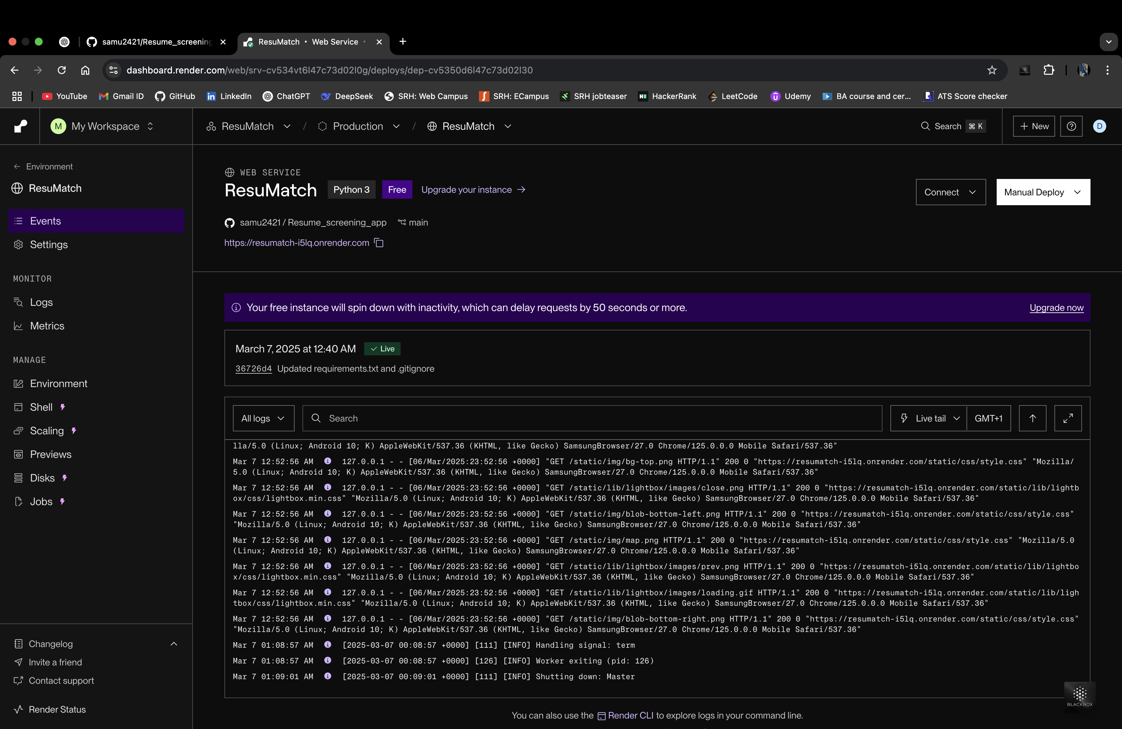
Deployment
Render: Deployed the application on Render (using the gunicorn package in python) to allow users to upload resumes, get predictions, and view results.
Hosting Details: The app runs on a cloud server, ensuring scalability and availability.
Web app URL: “https://resumatch-8dk2.onrender.com”

Slide 12
Future Improvements
Enhanced Skill Extraction: Integrate more advanced NLP techniques to identify skills more accurately.
Expanding the Dataset: Use a larger and more diverse dataset for better job category predictions.
Real-Time Job Matching: Improve the real-time job match scoring system with more complex algorithms.
User Feedback Loop: Collect user feedback on the predictions to improve the system.

Slide 13
Conclusion
The project successfully automates the process of resume screening and job categorization using NLP and machine learning.
It can help streamline recruitment processes by offering quick insights into job-relevant skills and resume-job match.

